Slide 1
Extractive Industries Transparency Initiative
Germany

Slide 2
D-EITI-Presentation
A collection of slides
(May 2025)

Slide 3
Content
What is the EITI?
EITI in Germany
Current implementation status of the EITI in Germany
D-EITI and the EU Accounting Directive
D-EITI photos
More information and contact

Slide 4
1. What is the EITI?

Slide 5
What is the EITI?
The Extractive Industries Transparency Initiative (EITI) was founded in 2003 and is an international standard to promote a transparent and accountable management of natural resources in the oil, gas and mining industries.
Countries that implement EITI commit to publish key information on their national extractive sectors, such as tax payments, licenses, contracts and production data.
Mission: „We believe that a country’s natural resources belong to its citizens.”

Slide 6
Why is EITI globally important?
Improved management of public revenues
Improved investment climate
More favourable loans
The fight against corruption
Information dissemination to and participation of the population

Slide 7
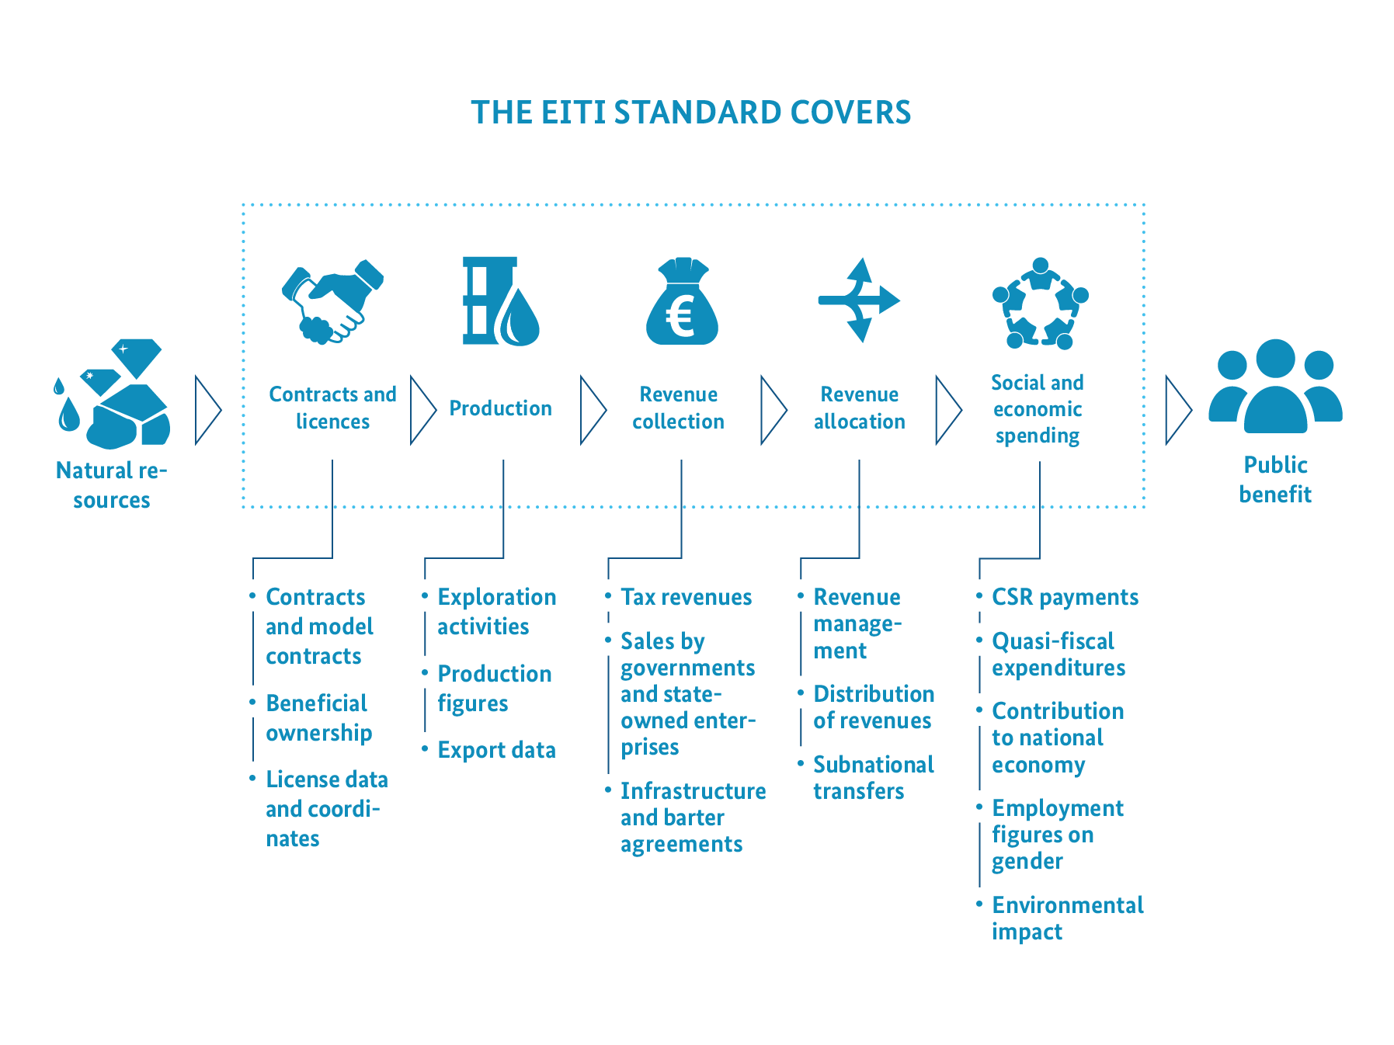
On which topics does the EITI focus?
Source: International Secretariat

Slide 8



How does the EITI work?
A national multi-stakeholder group (MSG) (government, private sector, civil society) decides on the shaping of the EITI process
Key information about the extractive sector is published annually in an EITI report.
This information stimulates a public dialogue about how raw materials can be better managed.

Slide 9
Facts and figures about the EITI
54
countries implement the EITI standard
More than US$2,64 trillion
government revenues were disclosed
More than 675 fiscal years
were disclosed in open data format
More than 250
NGOs are committed to the EITI – locally and internationally
More than 60
large extractive companies officialy support the EITI
Source: International Secretariat (April 2025)

Slide 10
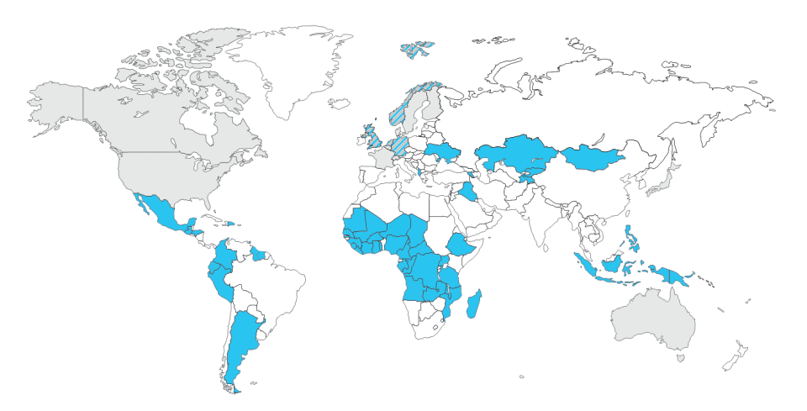
EITI implementing countries
Two EU countries
Six OECD countries
Two G7 countries
Status of the map: January 2025

Slide 11
Further development of the EITI-Standard
The newest EITI-Standard was adopted in 2023 at the EITI-World Conference in Dakar, Senegal
It includes several new and refined provisions.
This enables countries to respond to the most pressing challenges that concern natural resource governance today
Four focal areas of the 2023 EITI-Standard:
Anti-corruption
New provisions enhance opportunities for countries and companies to use the EITI platform to identify and address corruption risks in the natural resource sector.
Energy Transition
New provisions support disclosures and public debate on the impacts of the energy transition by shedding light on relevant policies, as well as the revenues that countries can expect to receive from their oil, gas and minerals under different market scenarios.
Gender, social- and environmental issues
To help ensure that natural resources are managed in the interest of all citizens, there are strengthened provisions on promoting greater diversity in decision-making and disclosures that consider gender, social and environmental issues.
Revenue collection
New and refined provisions require more comprehensive and detailed disclosures, which can help countries strengthen their tax base and raise revenues.

Slide 12
2. Why EITI in Germany?

Slide 13

Why EITI in Germany?
Supporting the international agenda in the fight against corruption
→ Cooperation on equal terms
Objectifying the discussion and increase understanding in the German public for domestic resources extraction
→ esp. in times of changing framework conditions (e.g. CRMA)
Multi-stakeholder model as an innovative forum and a pioneer for dialogue
→ Trilateral network useful even beyond D-EITI
„Lead by example“, and contribute to the creation of a „level playing field“ in the global resource sector
→ Innovative implementation and risk based quality assurance
Implementing the principles of open data
→ improving affiliation with citizens, service quality and innovation in the public administration
Preparing German industries for international transparency requirements
→ Direct alignment with public (civil society) needs through multi-stakeholder-process

Slide 14
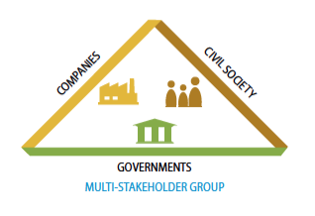
Who is implementing the EITI in Germany?
A national Multi-Stakeholder Group (MSG) consisting of representatives from government, private sector and civil society decides on the shaping of the EITI process.

Slide 15

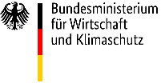

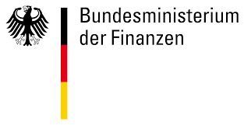















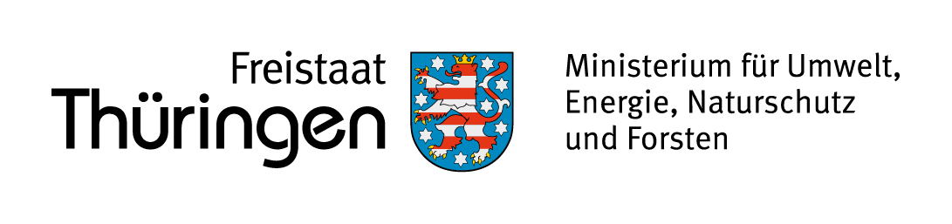

The German MSG
Companies
Governments
Civil Society

Slide 16
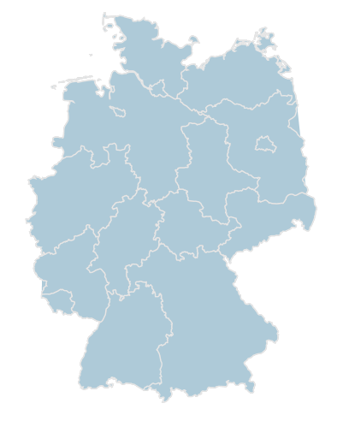
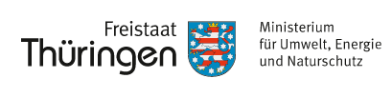
Implementation of the EITI in a federal state
EITI reporting primarily relates to the mandates of the Federal States.
The provincial governments were involved in the multi-stakeholder process from the outset, in the form of a Federal-State Working Group (WG).

Slide 17
The seven objectives of D-EITI set by the MSG
Produce timely reports that are understandable and accessible to the general public and based on a transparent, open and innovative EITI process in Germany.
Process contextual information concerning the German extractive sector, with a view to promoting a broad debate on resource policy that includes aspects of sustainability (economic, environmental, and social).
Engage in understandable, commensurate and increasingly comprehensive reporting to the general public in compliance with the EITI Standard and in harmony with the EU Accounting and Transparency Directives. Concomitantly, additional value shall be generated.
Contribute to the further development of the EITI Standard and its implementation and acceptance as a de-facto global standard, to support the global striving for transparency and accountability as well as the fight against corruption in the extractive sector.
Share experience from the multi-stakeholder process, in particular with respect to participatory democracy, citizen engagement and knowledge transfer, and also with regard to EITI implementation in a federal state.
Substantially enhance Germany’s credibility as regards its political and financial support for EITI.
Ensure ongoing implementation of the D-EITI with the intended multi-stakeholder model while building capacity for broad-scale public debate.

Slide 18
Seven D-EITI objectives - three core topics
Development of an UNDERSTANDABLE D-EITI REPORT, one which promotes the dialogue on the national extractive sector.
Contribution to the development of the EITI standard as a GLOBAL TRANSPARENCY STANDARD.
SHARING OF KNOWLEDGE and experiences regarding the multi-stakeholder process in a federal state.

Slide 19
The German process to an EITI-compliant country
EITI- Pilot
Adoption
of candidacy
2014
1st D-EITI report
2016
1st Validation
2018
EITI-compliance 2019
Annual D-EITI reports
Pilot on risk based quality assurance
2021
2nd Validation
2023
EITI compliant country
Integration of the risk based quality assurance in the international EITI ToR
2024
EITI candidacy country

Slide 20
4. Key areas of work of EITI in Germany

Slide 21
The D-EITI report
The extractive industry in Germany
Which raw materials are extracted and where?
Focus: oil, natural gas, coal, potash and salts, earth and stone, and industrial minerals and metals
Which revenues are generated by the extractive industries?
incl. corporation tax, mine site and extraction royalties
Special Topics
incl. dealing with human intervention in nature and landscape, state subsidies and tax concessions, renewable energies, environmental protection, recultivation and renaturation, employment and social affairs, circular economy, especially recycling as well as effects of the energy transition and structural change on raw material extraction in Germany.
From 2023: Contribution of domestic raw material extraction to security of supply, including Germany's role in the international raw materials market
State administration of the extractive industry
incl. who owns raw materials?, legal framework, licenses
Importance of the extractive industry in Germany
Contribution to GDP, to government revenue, employment and exports

Slide 22

D-EITI report: Highlights
The report contains comprehensive information about the German extractive sector.
The MSG has included compensation measures, circular economy in particular recycling, employment and social affairs and natural resource demand in the field of renewable energies as additional topics that are not specified by the EITI standard.
All contents were developed by the three stakeholder groups and decided by consensus.
All information is also available on www.d-eiti.de. All data is available in Open Data Format.

Slide 23
Payments 2022 – 7th D-EITI Report
The following overview shows the payments made in 2022 by the participating companies to government agencies including corporation tax, trade tax, mine site and extraction royalties as well as lease payments and payments for infrastructure improvements.
 | Corporation tax EUR | Trade tax EUR | Extractive & mine site royalties EUR | Lease payments EUR | Payments into the infrastructure EUR | Total EUR
Total amount of reported payments from all companies | 285.218.716,89 | 270.539.178,29 | 225.148.254,09 | 4.080.774,70 | 17.567.414,72 | 802.554.338,69

Slide 24
5. D-EITI and EU Accounting Directive

Slide 25
D-EITI and EU Accounting Directive
With the Accounting Directive Implementation Act (Bilanzrichtlinie-Umsetzungsgesetz) transparency regulations for companies in the extractive sector and their payments to government agencies were incorporated into the German Commercial Code (Handeslgesetzbuch).
By closely linking D-EITI reporting with statutory reporting and disclosure requirements extra burdens for companies were avoided.

Slide 26
Comparison of the D-EITI and the German Commercial Code
 | German Commercial Code | D-EITI
Materiality threshold | €100.000 per payment | €100.000 per payment
Criteria for the size of companies* | Balance sheet total: €20 revenues: €40 million 250 employees | Balance sheet total: €20 revenues: €40 million 250 employees
Information that gives the general public an overview of the extractive sector operations | n.a. | Provided in the context report
Cross-interest dialogue on the contribution of the extractive sector in Germany | n.a. | Through the Multi-Stakeholder Group
Is reporting mandatory? | Yes, penalty payments are due in case of violations | No, no sanctions for companies, but possible threat to EITI status
* "Large" in the legal sense is defined as companies that exceed at least two of the three criteria mentioned above on two consecutive balance sheet dates (§ 267 Abs. 3 HGB).

Slide 27
6. D-EITI photos

Slide 28
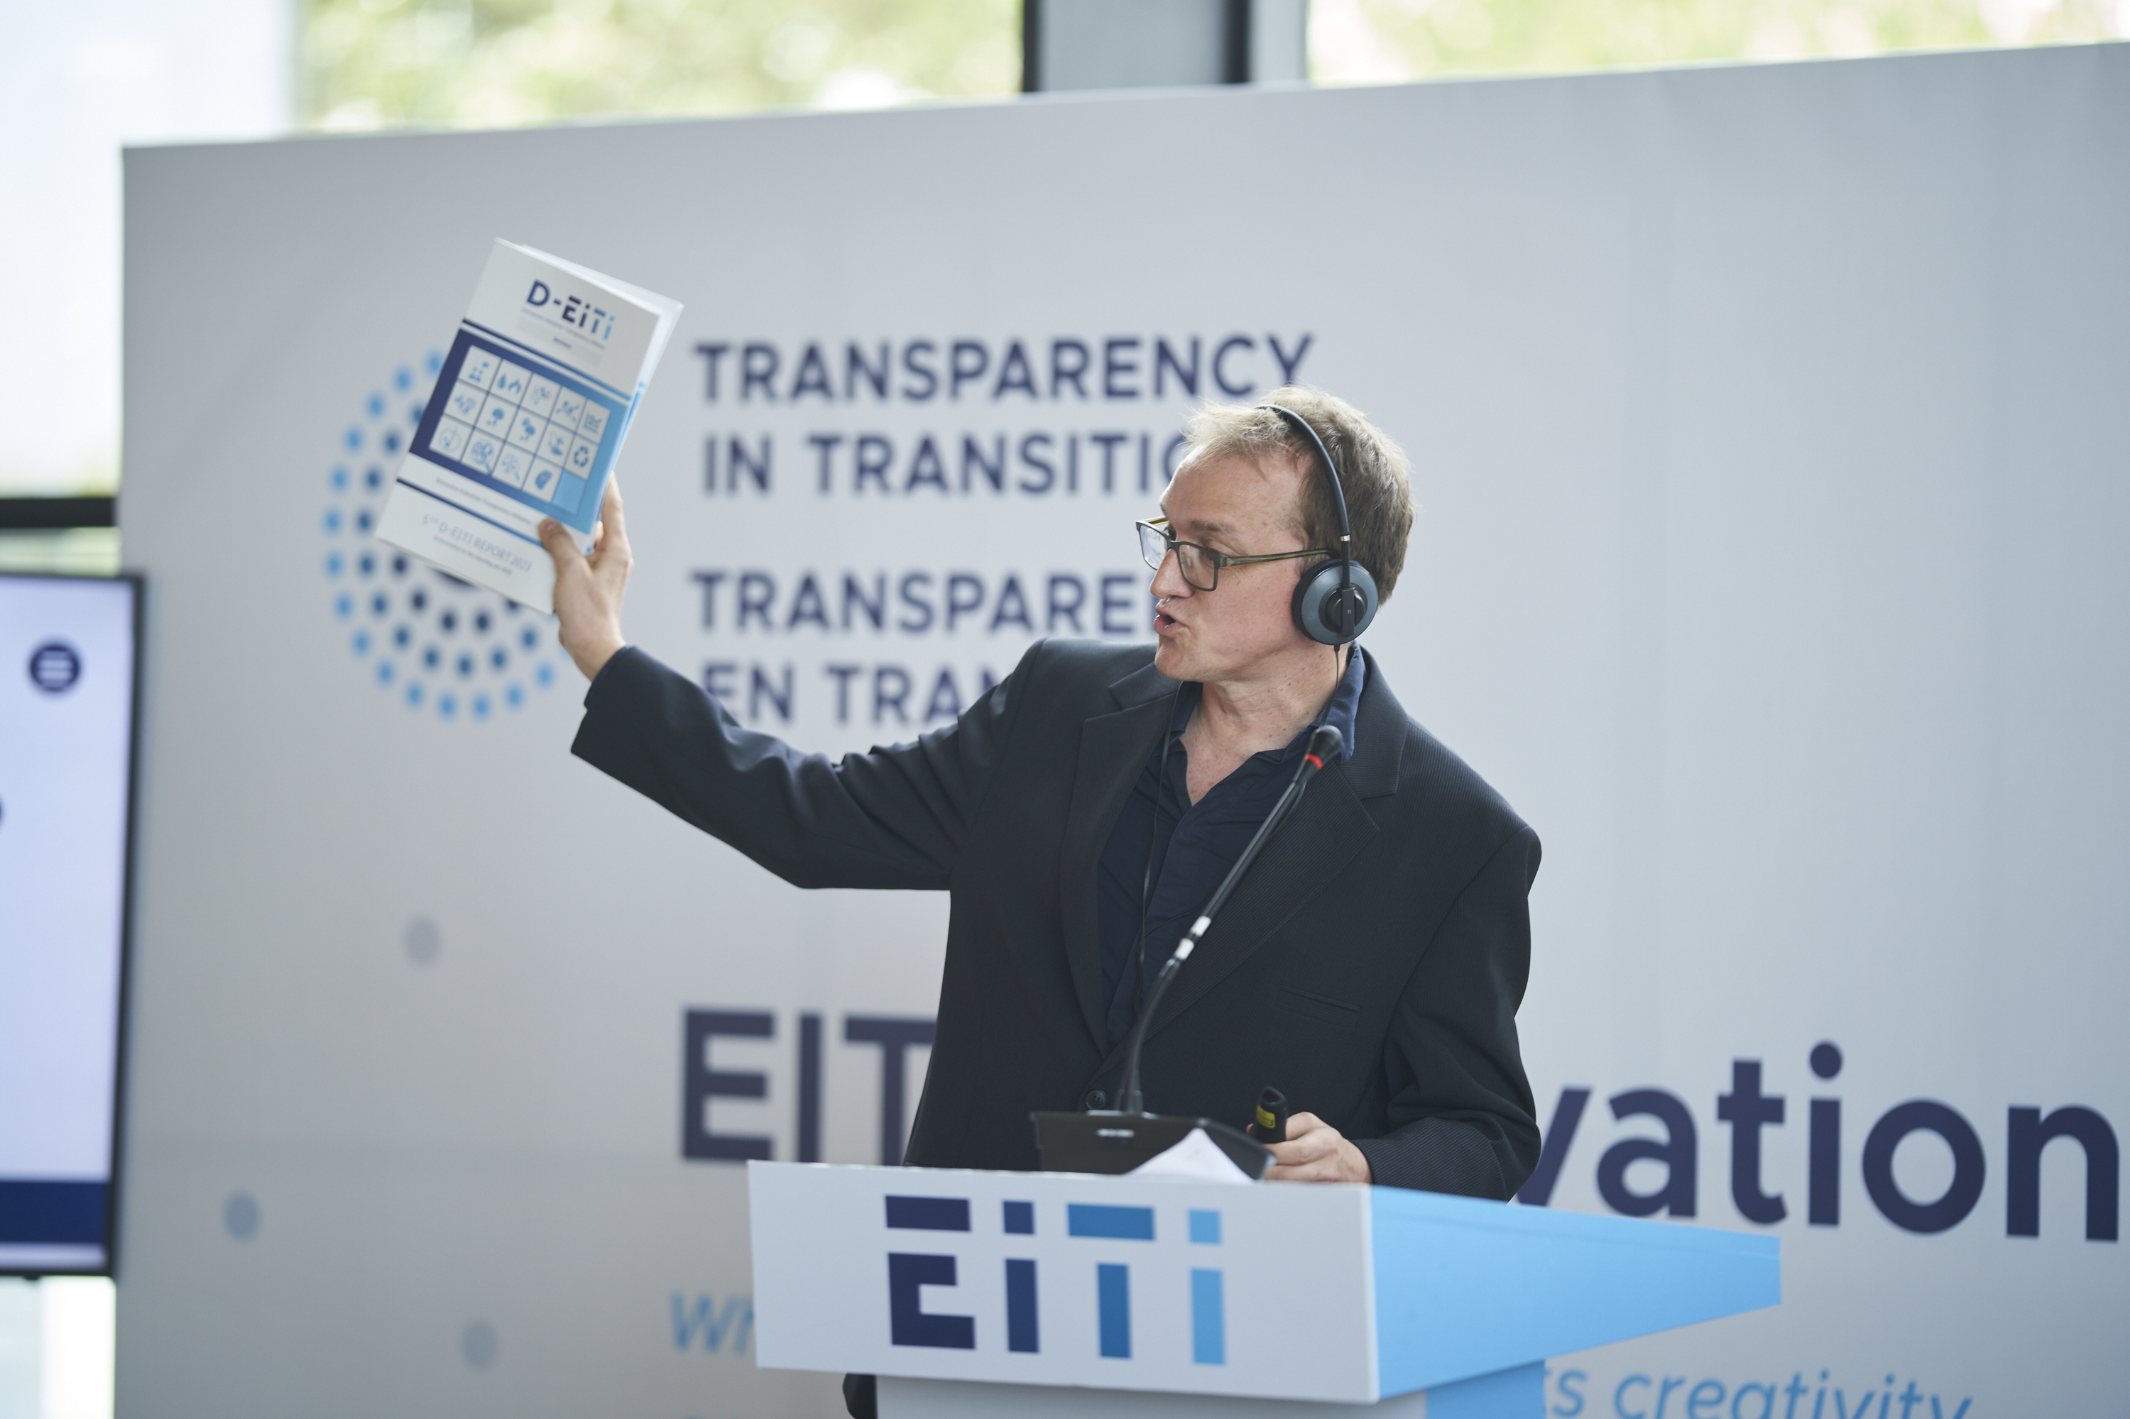


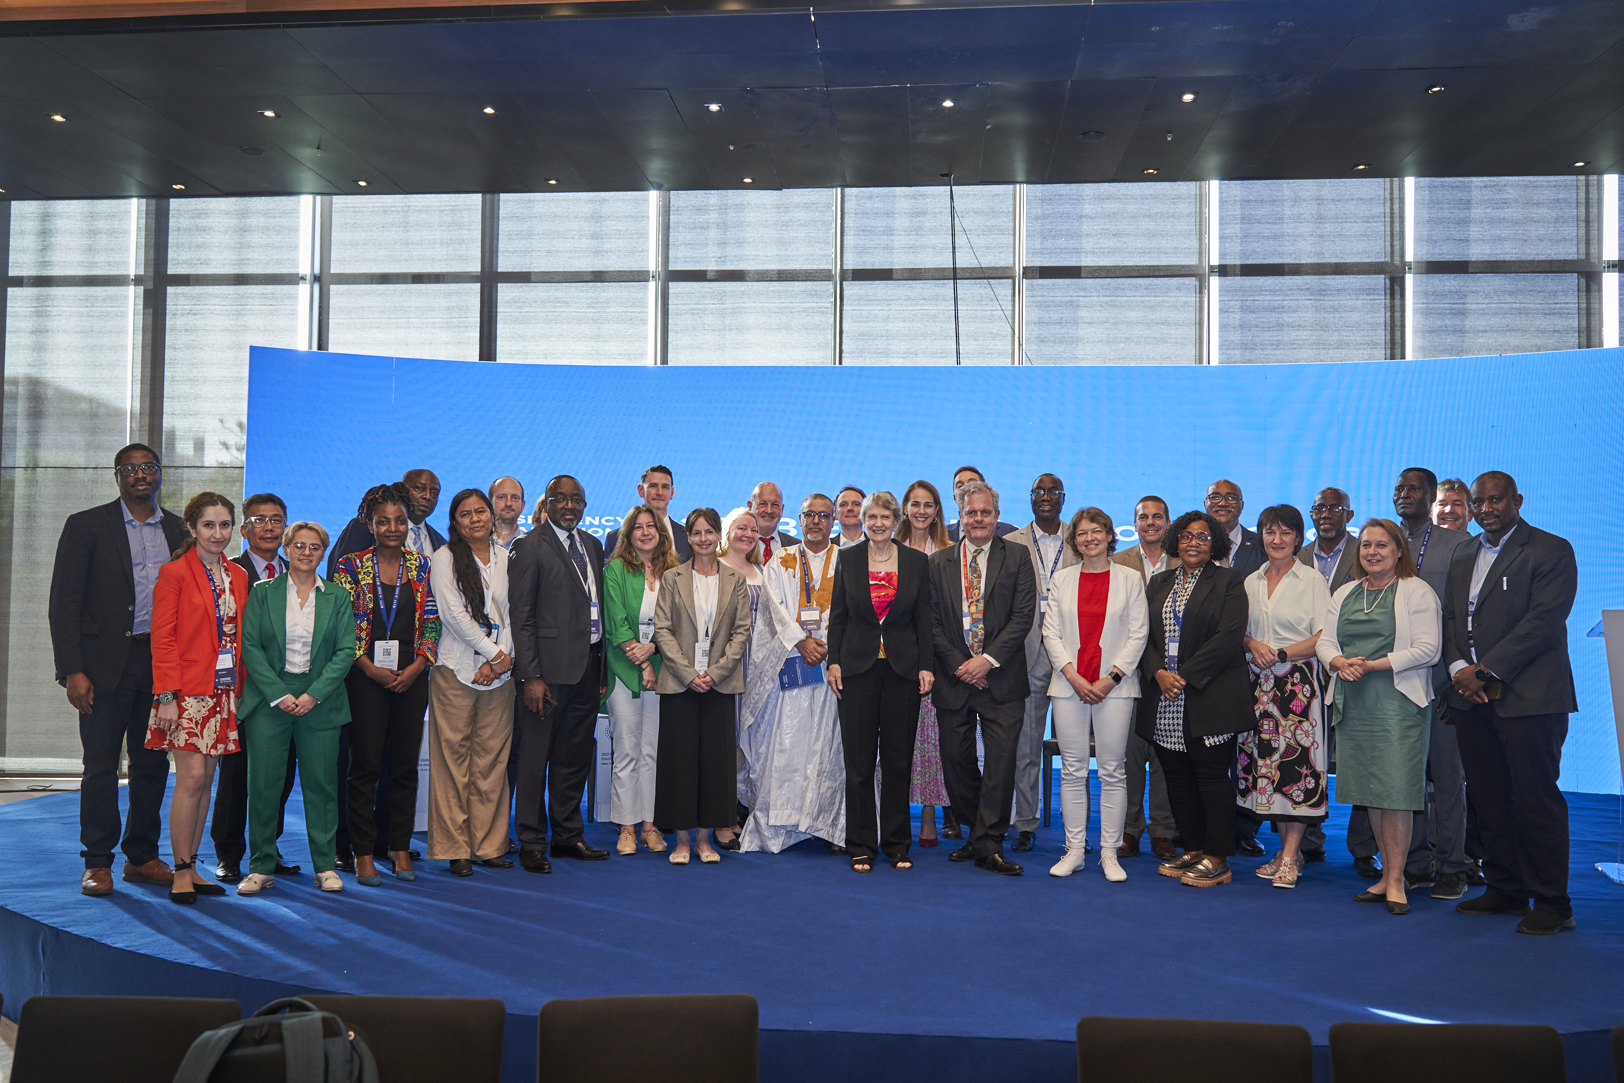

D-EITI members at the EITI-World Conference in 2023 in Dakar, Senegal

Slide 29
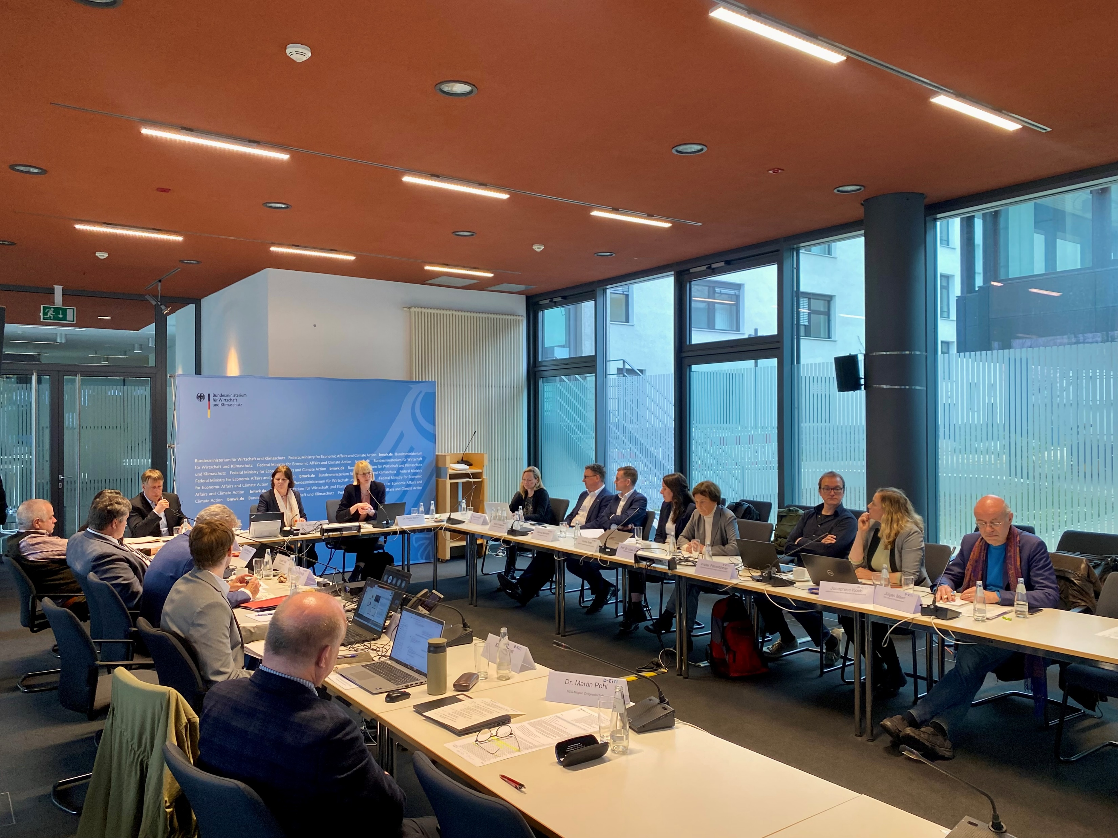
MSG-members at the 31. MSG-meeting – March 2025

Slide 30
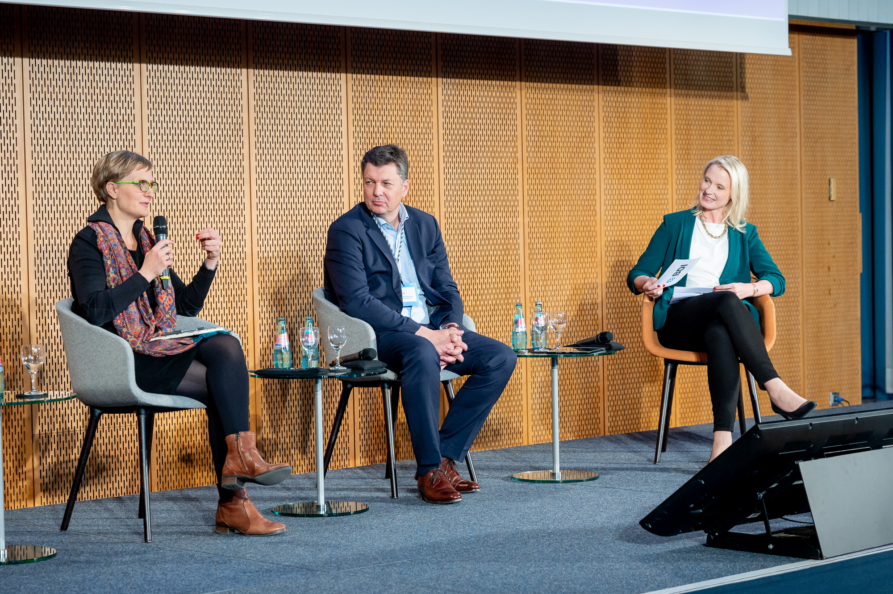
Special representative Dr. Brantner at the BDI Raw Materials Conference in 2022

Slide 31
7. More information and contact

Slide 32


More information about D-EITI
Website:
www.D-EITI.de
@ Kontakt
sekretariat@d-eiti.de
LinkedIn
D-EITI (Extractive Industries Transparency Initiative)

Slide 33
Contact
D-EITI-Secretariat
Reichpietschufer 20
10785 Berlin
___________________
Tel.: +49 30 – 72 614 – 207
E-Mail: sekretariat [at] D-EITI.de
www.D-EITI.de

